Slide 1



JavaScript ES6 - Objects
Mark J. Buckler
OCPJP,CIWJS

Slide 2

Credits
Some of the contents of this slide presentation have been referenced and reproduced, from Switching to ES6 in Node.js, by Ryan Lewis, ©2017 LinkedIn Corporation.

Slide 3
LEARNING OBJECTIVES
Declaring Variables
Array Destructuring
Object Destructuring
Shortened Object Property Declarations
Object Function Property Shorthand
Template Strings and String Interpolation

Slide 4
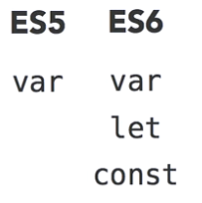
Declaring Variables
Variable Declarations
There are new keywords in ES6 for variable declarations
The purpose is to introduce changes to the scope rules of ES6
ES5 has only global scope and function scope
Most languages support the concept of block scope
The let and const keywords both provide block scoping capabilities

Slide 5
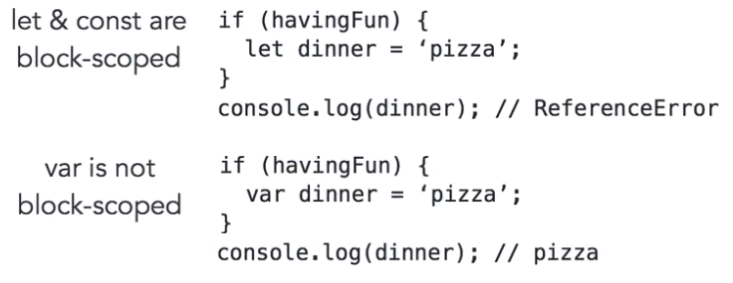
Declaring Variables
Variable Declarations
Code blocks are defined in JavaScript with pairs of curly braces
Block scoped variables declared with let & const are out of scope outside their code blocks

Slide 6
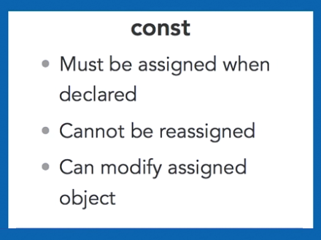
Declaring Variables
const Declarations
The keyword const stands for constant
An object declared with const may not be changed, but its properties may be modified

Slide 7
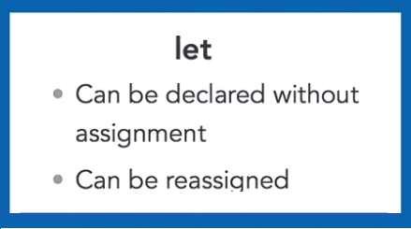
Declaring Variables
let Declarations
The keyword let declares regular variables
A variable declared with let has block scope
The value may be reassigned an unlimited amount of times

Slide 8
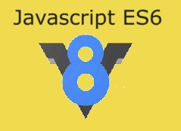
Declaring Variables
Programming Exercise03_02_01 – Step 1
Using let and const Variable Declarations

Slide 9
Array Destructuring
Destructuring
ES5 assignment is a singular process
There is only one variable on the left hand side
Only one value from the right side is assigned to it
ES6 destructuring enables assignment to multiple left hand side variables in one statement
The right hand side values may be complex arrays or objects
Left side variables can be one or more independent variables
They can also be one or more object properties

Slide 10
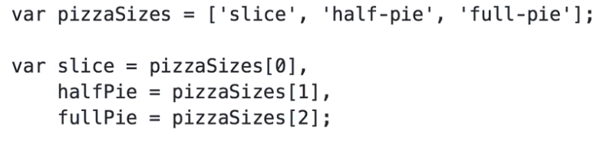
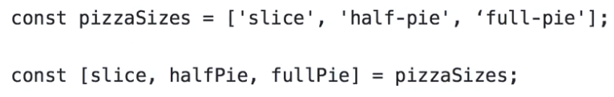
Array Destructuring
Destructuring
ES5 assignment from arrays to variables
ES6 assignment from arrays to variables with destructuring
In destructuring from arrays, left side must use square brackets
But results are independent variables

Slide 11
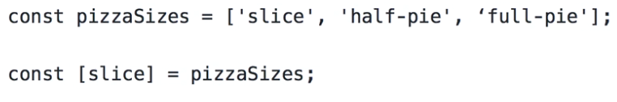
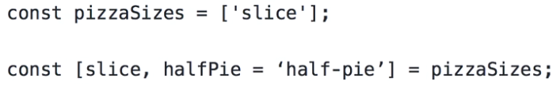
Array Destructuring
Destructuring
ES6 assignment from arrays does not have to use all the elements of a right side array
Destructuring is done in strict order
Default parameters may also be used in destructuring

Slide 12
Array Destructuring
Programming Exercise03_02_01 – Step 2
Using Array Destructuring

Slide 13
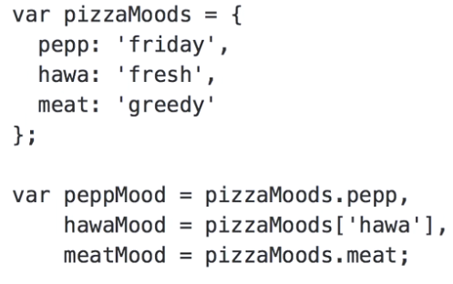
Object Destructuring
Destructuring
ES5 assignment from objects to variables
Dot ( . ) or bracket ( [ ] ) notation may be used

Slide 14
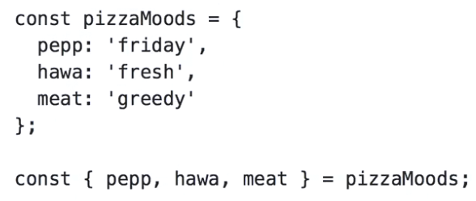
Object Destructuring
Destructuring
ES6 assignment from objects to variables
Curly brace ( { } ) notation is used
In object destructuring the order does not matter
Properties are assigned by name, regardless of order

Slide 15
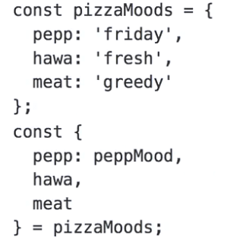
Object Destructuring
Destructuring
ES6 assignment from objects to variables
The object being assigned to may also be customized by assigning a different value to it

Slide 16
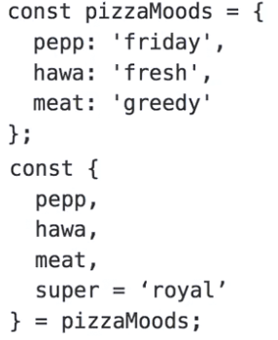
Object Destructuring
Destructuring
ES6 assignment from objects to variables may also make use of default values

Slide 17
Object Destructuring
Programming Exercise03_02_01 – Step 3
Using Object Destructuring

Slide 18
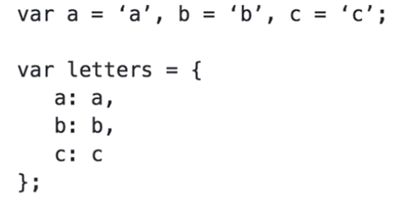
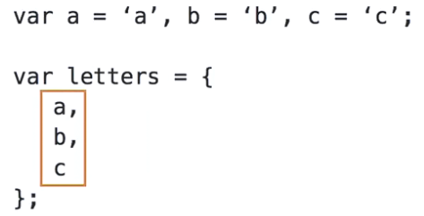
Object Property Declarations
Property Declaration
ES5 object declaration, when names and values are the same
ES6 allows a shortened syntax that does the equivalent
Properties can be set by referencing only the variable
Variable identifier set as the key, variable value set as the value

Slide 19
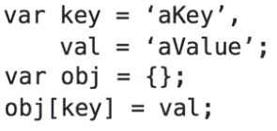
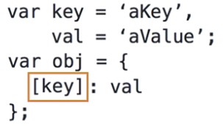
Object Property Declarations
Computed Property Names in ES6
ES5 declaration, using dynamic key names
ES6 allows a shortened syntax that does the equivalent

Slide 20
Object Property Declarations
Programming Exercise03_02_01 – Step 4
Using ES6 Property Declarations

Slide 21
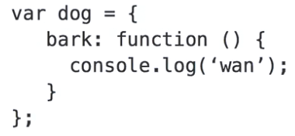
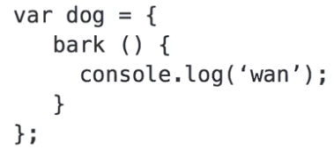
Object Function Properties
Function Property Declarations
ES5 function property declaration
ES6 allows a shortened syntax that computes the property name

Slide 22
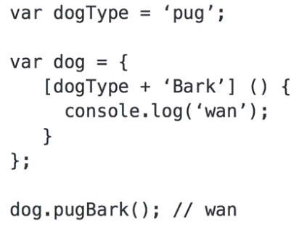
Object Function Properties
Computed Function Property Declarations
ES6 allows a syntax that computes the function property name

Slide 23
Object Function Properties
Programming Exercise03_02_01 – Step 5
Using ES6 Function Property Declarations

Slide 24

Strings and ES6
String Delimiters
ES5 strings are delimited by single ( ’ ’ )or double ( ” ” ) quotes
ES6 introduces the concept of template strings
Delimited by back-ticks ( ` ` ) instead of quotes
Can be used for normal strings
Multi-line strings
String interpolation

Slide 25
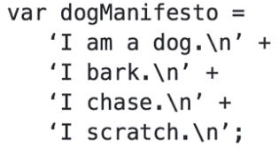
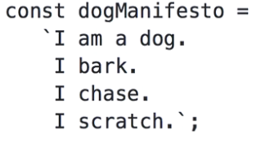
Strings and ES6
Multi-line Strings
ES5 multi-line strings
ES6 allows a shortened syntax called a template string
Concatenation and close quote symbols removed
The newline characters are included in the string

Slide 26

Strings and ES6
String Interpolation
ES5 dynamic strings use concatenation or the comma operator
ES6 template strings use string interpolation with dollar sign & curly bracket ( ${.. } ) notation
Dynamically execute JavaScript inside the string, even functions

Slide 27
Strings and ES6
Programming Exercise03_02_01 – Step 6
Using ES6 Template Strings

